Slide 1
eVTOL Operating Cost Estimation

Slide 2
Purdue paper (Howard et al., 2021)
Models direct operating cost (DOC) for four vehicle types and 13 UAM vehicles
Vectored thrust
Multicopter
Lift + cruise
Helicopter
Elements considered in DOC:
Vehicle acquisition
Crew and avionics
Energy
Maintenance
Infrastructure
Indirect operating cost (IOC) includes sales, marketing, passenger insurance, and other similar costs
IOC is argued not to vary by aircraft type, so not considered in the study
Howard, R. J., Wright, E., Mudumba, S. V., Gunady, N. I., Sells, B. E., & Maheshwari, A. (2021). Assessing the suitability of urban air mobility vehicles for a specific aerodrome network. In AIAA aviation 2021 forum (p. 3208).

Slide 3
Acquisition cost
Includes airframe acquisition, battery acquisition, and insurance rate
Airframe acquisition cost
Early production rates at $300/lb MTOW, except multicopter which will be at $150/lb MTOW
2,000 flight hours per year with a life span of 10 years
Battery acquisition cost
Assumed at $400/kWh
2,000 cycles lifetime (Joby S4 has $10,000 cycles)
Calculate the number of battery lifetimes required for 20,000 flight hours based on nominal trip time to determine the number of times batteries will be replaced, and total battery cost*
Insurance rate: 3% per year
* The battery capacity of the studied eVTOLs can be found at an accompanying website: https://purr.purdue.edu/publications/3816/1

Slide 4
Crew and avionics cost
Consider piloted eVTOLs
50% more pilots than the number of eVTOLs to account for shift changes
Each pilot flies 1,333 hrs per year
A yearly pilot cost assumed at $110,000
Avionics cost is $19,035 based on a sister study for lifetime of eVTOL
Roy, S., Maheshwari, A., Crossley, W. A., & DeLaurentis, D. A. (2018). A study on the impact of aircraft technology on the future of regional transportation using small aircraft. In 2018 Aviation Technology, Integration, and Operations Conference (p. 3056).

Slide 5
Energy cost
Energy cost per flight hour is determined by the energy used by the eVTOL for a single trip and converting the value to per flight hour
Assume eVTOL uses 60% of its battery charge for a nominal flight and maintains 40$ for reserve
Use an energy cost of $0.144/kWh (for the Chicago region)

Slide 6
Maintenance and infrastructure costs
Maintenance cost: includes inspection and repair, based on Kohlman et al. (2019)
Assume vehicle maintenance cost at $60/hr
Each flight hour requires an hour of maintenance
Infrastructure cost: takeoff and parking fee
Based on a 1991 analysis of Manhattan Helipad in NYC adjusted to 2020 value
Infrastructure cost is the sum of all landing and parking fees accumulated in one flight hour
Kohlman, L. W., Patterson, M. D., & Raabe, B. E. (2019). Urban air mobility network and vehicle type-modeling and assessment (No. ARC-E-DAA-TN64561).
Peisen, D. J., & Lobosco, R. (1991). New York Downtown Manhattan (Wall Street) Heliport-Operations Analysis. SYSTEMS CONTROL TECHNOLOGY INC ARLINGTON VA.

Slide 7
DOC estimation result: DOC per flight hour

Slide 8
DOC estimation result: DOC per seat mile

Slide 9
Uber Elevate White Paper (2016)
Estimate cost per vehicle mile
Assumptions
Four-seaters with one pilot
Load factor: 67% (two pax on average)
Gross vehicle weight: 4,000 lb
Utilization: 2,080 hrs per year
eVTOL being flight ready for 50% of the time between 6am and 10pm
Operate 260 days/year

Slide 10
Three cases considered

Slide 11
Additional assumptions
Battery:
140 kWh capacity: permit flying two 50-mile trips (10 min wait/rapid charging time in between) prior to recharging, while also providing sufficient energy for IFR reserves of 30 min at minimum cruise power and a short detour to an alternative landing location
400 wh/kg
2,000 cycle life
Power: 500 kw takeoff power with 1 min of full power at takeoff and landing; 71 kw power at 150 mph cruise/120 kw at 200 mph cruise
Electricity cost: $0.12/kWh

Slide 12
Additional assumptions (cont’d)
eVTOL life:
13 years (25-27k hours or ~5 million miles of service)
Annual overhaul cost of $90-95/year
Residual value of 30% at salvage
Infrastructure cost
Consider 83 vertiports each capable of supporting up to 12 eVTOLs at a time
Initial infrastructure repurposing development cost: ~$121 million
Building modifications (e.g., retrofitting top level of a parking structure as a vertiport)
3 high voltage and 9 low voltage chargers (one for each eVTOL parking spot)
High voltage charger at $250k and low voltage charger at $100k
Amortized over 30 years
Annual infrastructure cost estimated at $86k/year per eVTOL

Slide 13
Additional assumptions (cont’d)
Vehicle maintenance cost
50% reduction than existing light helicopter mtce cost
Account for ~22% of baseline eVTOL DOC
Indirect operating cost
Non-vehicle specific cost such as credit card processing fees, registration and permit fees, insurance, and other smaller fees
Modeled as ~12% on top of DOC

Slide 14
Estimation results ($/vehicle-mile)

Slide 15
NASA 2018 Urban Air Mobility Market Study
Estimation method described, but lacking technical detail and parameter values
High degree of uncertainty as indicated by the grey bars

Slide 16
Operating cost composition based on NASA (2018)

Slide 17
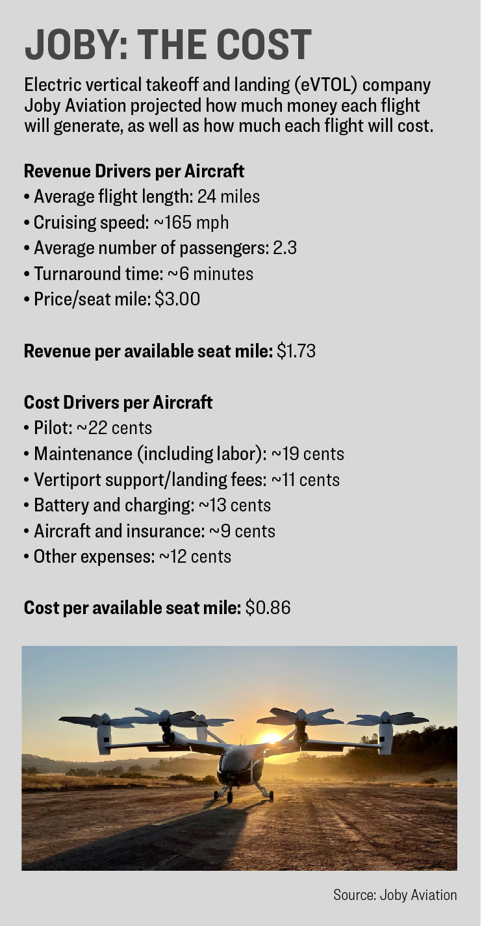
Other estimates from news articles (I)
How much will it cost to fly on eVTOL air taxis? Source: https://www.flyingmag.com/evtol-air-taxi-passenger-prices/

Slide 18
Joby Aviation Analyst Day presentation, June 2021. Source: https://www.sec.gov/Archives/edgar/data/1819848/000119312521180727/d175333d425.htm

Slide 20
Other estimates from news articles (II)
Lilium projected in 2026 the projected cost in its 6-passenger eVTOL to be $2.25/pax-mile
Assumptions: an average of 4.5 out of 6 pax seats being filled, with 25 flights per day traveling at an average distance of 60 miles for 10 flight hours per day
Uber service in 2026: reported the same cost estimates as the other article
Counting the cost of urban air mobility flights Source: https://www.futureflight.aero/news-article/2021-11-15/counting-cost-urban-air-mobility-flights

